Slide 1
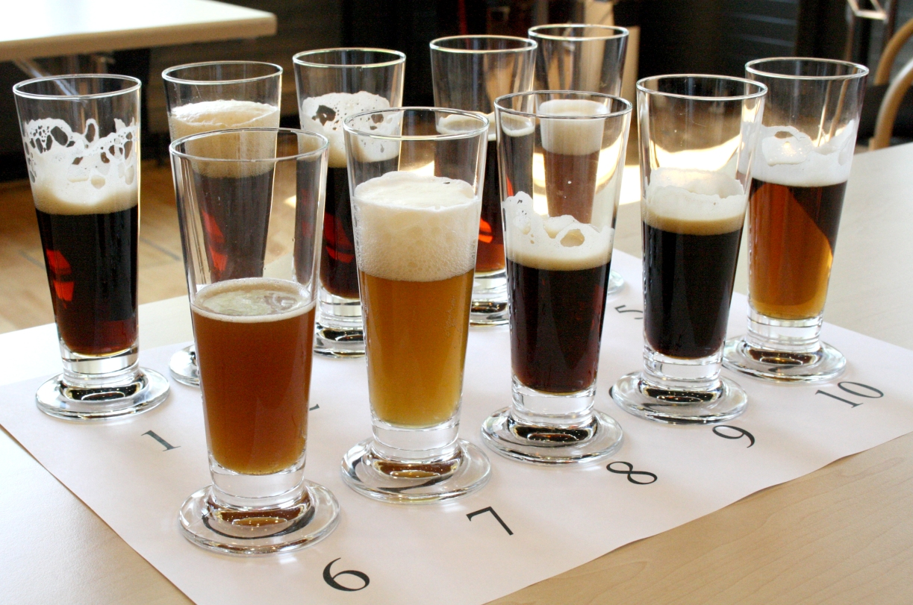

Slide 2
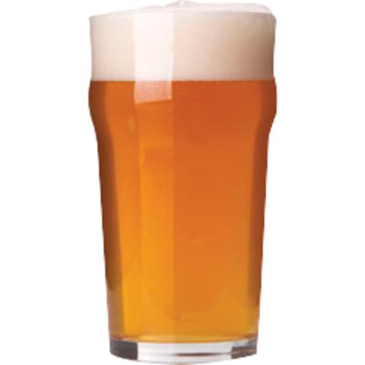
Blind
A
B
C
D
E
all possible comparisons (10)

Slide 3
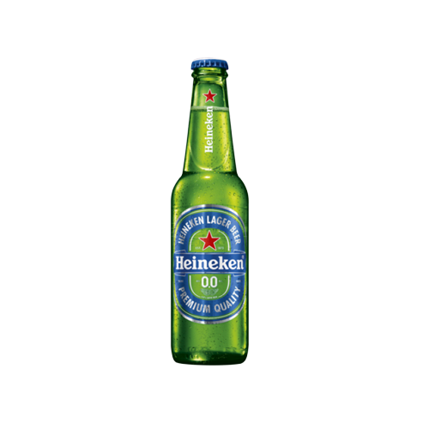
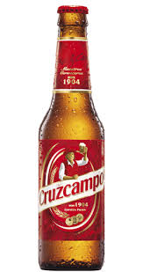
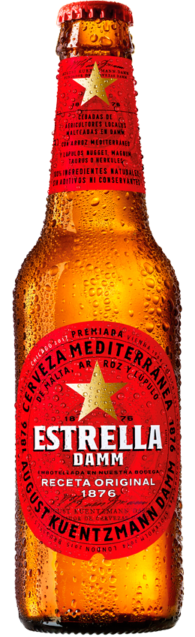
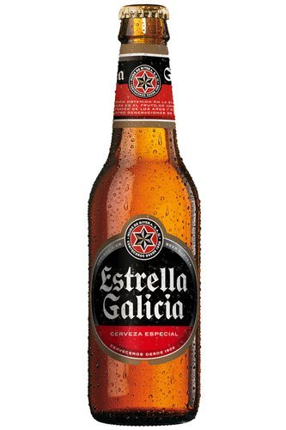
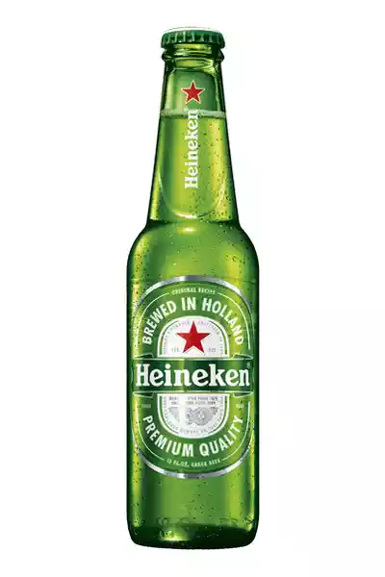
Seen
all possible comparisons (10)

Slide 4
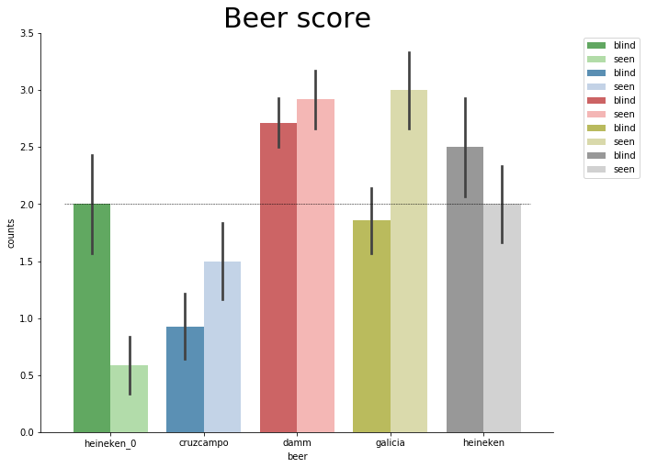
N=12 (seen) + 2 just unseen

Slide 5
Is any beer objectively /subjectively better or worse than the others?
blind / seen

Slide 6
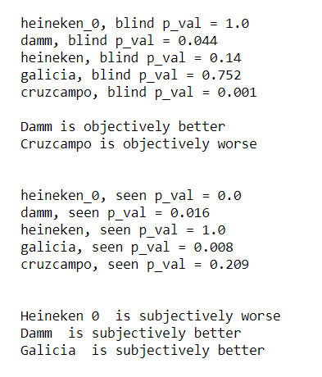
Is any beer objectively /subjectively better or worse than the others?
blind / seen
N=12 (seen) + 2 just unseen
blind
seen

Slide 7
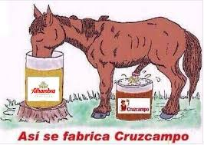

Objectively (Blind)

Slide 8
Is any beer objectively /subjectively better or worse than the others?
blind / seen
N=12 (seen) + 2 just unseen
blind
seen

Slide 9
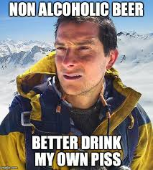
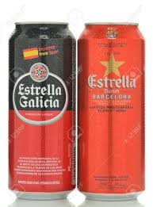
Subjectively (seen)

Slide 10
Are we socially biased?

Slide 11
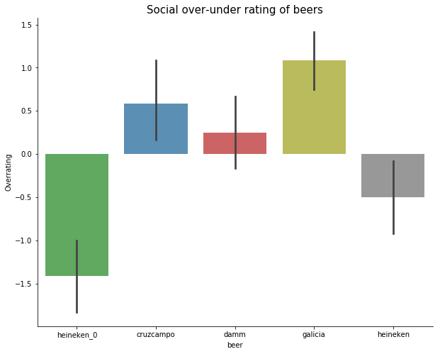
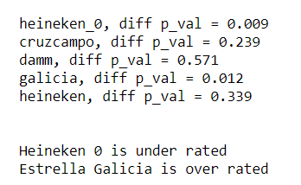

Slide 12
